Slide 1
Pathophysiology of Obesity: Appetite Regulation and Metabolic Adaptation
Module 2

Slide 2
Pathophysiology of Obesity: Appetite Regulation and Metabolic Adaptation

Slide 3
Thank you for using the FORWARD: Focus on Obesity Education curriculum.
Novo Nordisk Inc. provided funding support for the FORWARD: Focus on Obesity Education curriculum. A third-party provider developed the content in consultation with Novo Nordisk Inc. and leading obesity clinician experts. FORWARD relies exclusively on open-source materials available to the general public.
The goal of FORWARD is to present a complete, accurate, non-promotional and fair-balanced picture of the current state of obesity. FORWARD is intended to inspire the development of obesity education in clinical professional schools, ensuring adequate training of future healthcare providers on the diagnosis and management of obesity. By choosing to access and browse this module of FORWARD, you acknowledge that you have read, understand and agreed to the FORWARD Terms of Use. If you do not agree with the FORWARD Terms of Use, you are not permitted to further access this module and should immediately discontinue your use.
Double click to view:

Slide 4
Learning outcomes
After completing this module, the learner will be able to:
Demonstrate a working knowledge of the biology of obesity including energy homeostasis and body weight regulation mechanisms
Demonstrate a working knowledge of metabolic adaptation physiology

Slide 5
Body weight regulation Historic perception^{1–3}
Energy intake
Energy expenditure
Physical activity (30%)
Thermic effect of food (10%)
Resting metabolic rate (60%)
↑ body weight
↓ body weight
1. Badman and Flier. Science 2005;307:1909–14; 2. National Institutes of Health (NIH): National Heart Lung and Blood Institute (NHLBI). Overweight and obesity: causes. Available at: https://www.nhlbi.nih.gov/health-topics/overweight-and-obesity. Accessed Aug 2022; 3. Calcagno et al. J Am Coll Nutr 2019;38(6):547–51.

Slide 6
Body weight regulation Holistic view^{1–6}
Short-term regulation: influences quantity of food intake
Long-term regulation: maintains constant nutrient stores
Obesity may result from a dysregulated system secondary to various physiological, genetic, and environmental factors
Hunger or satiety
Adipose tissue
Liver
Gut-brain axis
Pancreas
Signal pathways:
Body
Hormonal
Neuronal
Orexigenic
Anorexigenic
Brain
GI tract
…there is cross-talk between these pathways
GI, gastrointestinal. 1. Badman and Flier. Science 2005;307:1909–14; 3. Campfield and Smith. Best Pract Res Clin Endocrinol Metab 1999;13;13–30; 4. Chaudhri et al. Diabetes Care. 2008;31(suppl 2):S284-S289; 5. Farius et al. Metab Syndr Relat Disord 2011;9:85–9; 6. Rogge and Gautam. J Am Assoc Nurse Pract. 2017;29:S15-S29; 7. Woods et al. Int J Obes Relat Metab Disord 2002;26(Suppl. 4):S8–S10.

Slide 7
Role of the brain in appetite regulation
GLP-1, PYY, OXM, PP, amylin
increase satiety^{1,2}
Homeostatic eating
‘eating for hunger’
Ghrelin increases hunger³
GLP-1, glucagon-like peptide-1; POMC, pro-opiomelanocortin; PP, pancreatic polypeptide; PYY, peptide YY; OXM, oxyntomodulin. 1. Badman and Flier. Science 2005;307:1909–14; 2. van Bloemendaal et al. Diabetes 2014;63:4186–96; 3. Klok et al. Obes Rev 2007;8:21–34.

Slide 8
Role of the brain in appetite regulation
Opioid and cannabinoid receptors and dopamine control the motivation/drive to eat and the pleasure associated with food
Homeostatic eating
‘eating for hunger’
Hedonic
eating
‘eating for pleasure’
Berridge et al. Brain Res 2010;1350:43–64.

Slide 9
Role of the brain in appetite regulation
Thoughts
Homeostatic eating
‘eating for hunger’
Hedonic
eating
‘eating for pleasure’
Executive function
‘deciding to eat’
Behavioral interventions empower sustainable behaviors in controlling eating
Feelings
Behaviour
Vallis. Clin Obes 2019;9:e12299.

Slide 10
Hormonal appetite signaling
Organs and tissue that secrete appetite-regulating hormones in the periphery (examples):^{1–6}
Hormones are responsible for initiation and termination of eating
Appetite-regulating hormones are secreted from the periphery to regulate energy balance in response to:^{1–6}
Stomach
Intestines
Pancreas
Adipose tissue
Fasting
Intake of a meal
A need to regulate energy stores
Ghrelin
CCK
GLP-1
PYY
OXM
Amylin
Insulin
PP
Glucagon
Leptin
Adiponectin
Orexigenic
(increase appetite)
Anorexigenic
(decrease appetite)
CCK, cholecystokinin; GLP-1, glucagon-like peptide-1; NPY, neuropeptide Y; OXM, oxyntomodulin; PP, pancreatic polypeptide; PYY, peptide YY. 1. Badman et al. Science 2005;307:1909–14; 2. Rogge, Gautam. J Am Assoc Nurse Pract. 2017;29:S15-S29; 3. Secher et al. J Clin Invest 2014;124:4473–88; 4. Seo et al. Endocr J 2008;55:867–74; 5. Suzuki et al. Exp Diabetes Res. 2012;2012:824305; 6. Woods et al. Int J Obes Relat Metab Disord 2002;26:S8–10.

Slide 11
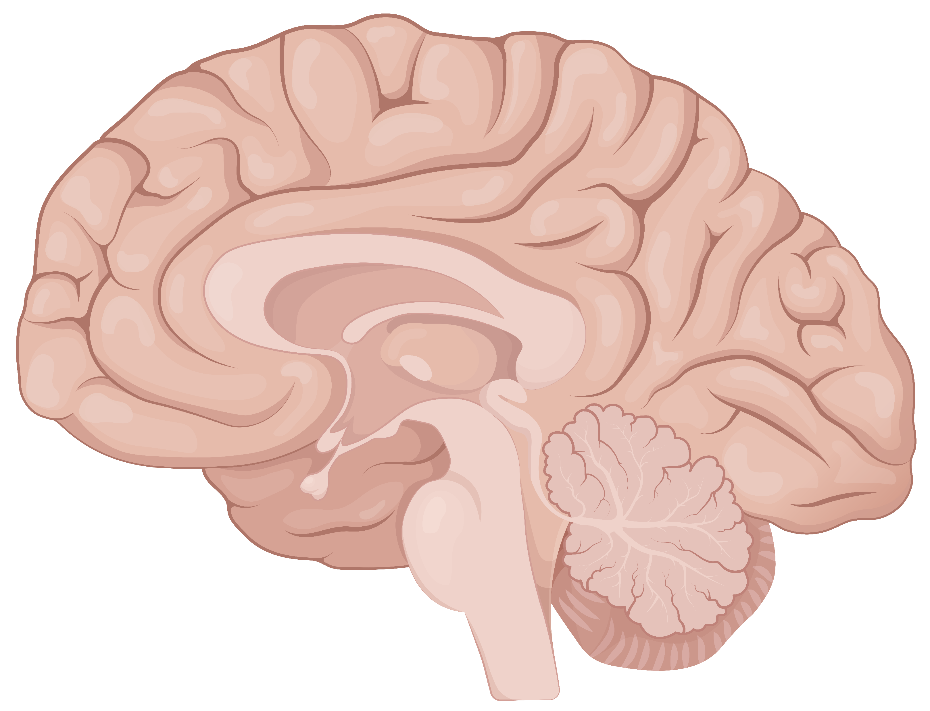
Hormonal appetite signaling^{1–6}
Orexigenic
Anorexigenic
Perception (via other ‘second-order’ neurons)
Hunger
Satiety
Hypothalamic integration (arcuate nucleus)
NPY AgRP
POMC
CART
Hormonal signals (examples)
Ghrelin
Amylin
CCK
Glucagon
GLP-1
Leptin
Insulin
PYY
Adiponectin
PP
OXM
Glucose
AgRP, agouti-related protein; CART, cocaine- and amphetamine-regulated transcript; CCK, cholecystokinin; GLP-1, glucagon-like peptide-1; NPY, neuropeptide Y; OXM, oxyntomodulin; PP, pancreatic polypeptide; POMC, proopiomelanocortin; PYY, peptide YY. 1. Badman et al. Science 2005;307:1909–14; 2. Rogge, Gautam. J Am Assoc Nurse Pract. 2017;29:S15-S29; 3. Secher et al. J Clin Invest 2014;124:4473–88; 4. Seo et al. Endocr J 2008;55:867–74; 5. Suzuki et al. Exp Diabetes Res. 2012;2012:824305; 6. Woods et al. Int J Obes Relat Metab Disord 2002;26:S8–10.

Slide 12
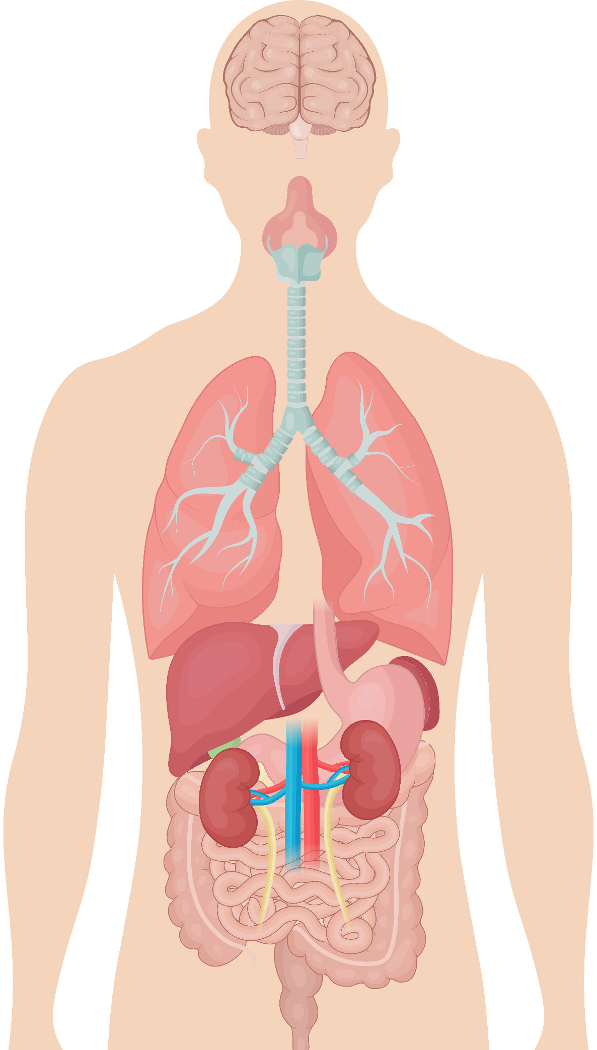
Neuronal appetite signaling
Hindbrain (Nucleus of the solitary tract)
The vagal afferent pathway
In the brain, communication between the nucleus of the solitary tract and the hypothalamus homeostatically regulates energy intake and expenditure, and ultimately body weight
Vagal afferent nerve
Signals from the periphery travel along the vagus nerve and are modulated by the presence of appetite-enhancing (ghrelin) or appetite-suppressing hormones (CCK, peptide YY, and GLP-1)
Abdominal viscera
Vagal afferents originate from the stomach, intestine and pancreas; they can inform about physical (gastric stretch receptors) and chemical (hormonal) stimuli by sending a signal from the periphery to the nucleus of the solitary tract via vagal afferent nerve fibers
CCK, cholecystokinin; GLP-1, glucagon-like peptide-1; peptide YY, peptide tyrosine tyrosine. Badman et al. Science 2005;307:1909–14.

Slide 13
Dysregulation of appetite and energy homeostasis
Lean adipocytes
Calorie-dense food
Hypertrophic adipocytes
Lean adipose tissue
Obesity adipose tissue
Systemic inflammation
↑IL 6, ↑TNFα, ↑IL-1β CCL2, CCL5, CXCL5
↑ Endothelial permeability ↑ Plaque development ↑ Atherosclerosis
↓ HDL and ↑ LDL cholesterol ↑ Glucose production ↑ Insulin resistance
↓ Glucose uptake ↑ Insulin resistance
↓ Insulin secretion
CVD
T2D
CCL, chemokine (C-C motif) ligand; CVD, cardiovascular disease; CXCL5, chemokine (C-X-C motif) ligand 5; HDL, high-density lipoprotein; IL, interleukin; LDL, low-density lipoprotein; T2D, type 2 diabetes; TNFα, tumour necrosis factor alpha. Yao L et al. J Immunol Res 2014;2014:181450.

Slide 14
Summary of appetite signaling
Body weight is regulated by hormonal and neuronal signals along the gut-brain axis
Hormonal signaling from the periphery to the brain is integrated in the arcuate nucleus of the hypothalamus
In the hypothalamus, orexigenic signaling is driven by upregulation of NPY and AgRP neurons and anorexigenic signaling is driven by upregulation of POMC and CART neurons
Neural and hormonal inputs from the periphery bind to receptors along the vagus nerve and terminate in the NTS or the hypothalamus
Integration of hormonal and neuronal systems regulate appetite, energy expenditure and feeding behaviors
Eat or exercise?
AgRP, agouti-related protein; CART, cocaine- and amphetamine-regulated transcript; NPY, neuropeptide Y; NTS, nucleus of the solitary tract; POMC, proopiomelanocortin.

Slide 15
Weight loss and maintenance is challenging
Therapies that promote weight loss (all aiming for calorie deficit)¹
Biologic adaptations respond to caloric deficits²
Subjective perception of appetite (↑ hunger/desire to eat)
Hormone levels (↓ satiety hormones; ↑ hunger hormone)
Metabolism (↓ energy expenditure)
Lifestyle-based
Pharmacologic
Surgical
The cycle of weight loss and weight regain may be emotionally, physically, and economically challenging^{3,4}
1. Garvey et al. Endocrine Practice. 2016;22:1-203; 2. Rogge, Gautam. J Am Assoc Nurse Pract. 2017;29:S15-S29; 3. Ulen. Clinical Diabetes. 2008;26:100-113; 4. Wadden et al. Ann Intern Med 1993;119:688–93.

Slide 16
Physiological responses to weight loss favor weight regain^{1–3}
Resting energy expenditure
Energy intake
Set point
+
↓ energy intake
↑ energy intake
↑ hunger ↓ metabolism
- Weight -
↓ hunger ↑ metabolism
1. Schwartz et al. Obes Rev. 2010;11(7);531-547; 2. Sumithran et al. N Engl J Med. 2011;365:1597-604; 3. Farius et al. Metab Syndr Relat Disord 2011;9:85–9.

Slide 17
Weight regain is common after diet-based weight loss intervention
Metabolic adaptation following weight loss
50 individuals with overweight/obesity lost weight on a 10-week very low energy diet, followed by gradual regain over the next year
Weight loss
95
All patients (ITT)
Adaptations that resist weight loss:
90
Weight (kg)
Hormone levels ↓ satiety hormones ↑ hunger hormones
Metabolism ↓ energy expenditure
85
80
0
Weight regain
0
10
18
26
36
44
52
62
Week
ITT, intention to treat. Sumithran et al. N Engl J Med 2011;365:1597–604

Slide 18
Postprandial hormonal changes to diet-based weight loss
Week 0
Week 10
Week 62
*
*
*
Plasma Concentration (pg/ml)
*
*
Plasma Concentration (fmol/ml)
*P<0.05 vs. baseline on a very-low-energy diet. CCK, cholecystokinin; GLP-1, glucagon-like peptide-1; PYY, peptide YY. Sumithran et al. N Engl J Med. 2011;365:1597-604.

Slide 19
Persistent metabolic adaption following “The Biggest Loser®” competition
Body weight
Resting metabolic rate
Metabolic adaptation*
–58 kg
–610 kcal/day
–704 kcal/day
+41 kg
–499 kcal/day
Baseline
Week 30
Year 6
Baseline
Week 30
Year 6
Baseline
Week 30
Year 6
Weight regain was observed 6 years after competition due to persistent metabolic adaptation counteracting weight loss
Error bars represent standard deviation. Data are for 14/16 participants in the 30-week The Biggest Loser® weight-loss competition. *Defined as the residual resting metabolic rate after adjusting for changes in body composition and age. RMR, resting metabolic rate. Fothergill E et al. Obesity (Silver Spring) 2016;24:1612–19.

Slide 20
Clinical impact of weight regain Longitudinal Assessment of Bariatric Surgery (LABS) cohort
HRQL, health-related quality of life. King et al. JAMA 2018;320:1560–69.

Slide 21
Key takeaways
Obesity is a chronic disease that occurs as a result of energy dysregulation causing excess caloric input and adiposity
Long term energy balance is centrally regulated by peripheral input on energy stores and nutritional state via neural and endocrine pathways
The body demonstrates a variety of adaptations to weight loss that promote weight regain after a caloric deficit
Although bariatric surgery provides the largest and most durable weight losses of any obesity intervention, weight regain is common and significant

Slide 22
Assessments
John is a 55-year-old man from Montgomery, AL and is home for the holidays. He has just finished eating a large Thanksgiving meal and no longer feels hungry. Which hormone secreted by the gut contributes to the reduction of his appetite?
amylin
leptin
glucagon-like peptide-1
ghrelin
John also has obesity and suffers from type 2 diabetes and cardiovascular disease. In both diseases, obesity-related systemic inflammation leads to which of the following increased effects in the liver?
glucose uptake
glucose production
insulin secretion
triglyceride uptake
John is a 48-year-old man with a body mass index (BMI) of 36 kg/m². He has recently made some lifestyle-based changes, which include caloric restriction and increased exercise. However, he finds it challenging to lose the weight and keep it off. Regardless of the intervention, what metabolic adaptation following weight loss makes it difficult for John to maintain the weight loss?
decreased resting metabolic rate
decreased levels of ghrelin
increased levels of amylin
decreased fat mass
Notes:
Answer Key
c (Slide 8; glucagon-like peptide-1 (GLP-1) is anorexigenic or appetite-reducing hormone secreted by the intestines)
b (Slide 11; For both T2D and CVD, systemic inflammation leads to increased glucose production in the liver)
a (Slides 14, 15; decreased resting metabolic rate makes it difficult to maintain weight loss)

Slide 23
Thank you for using the FORWARD: Focus on Obesity Education curriculum. To help us grow and improve the curriculum, we ask that you consider the following voluntary survey Participation in this survey is entirely voluntary and will not affect your access to and/or viewing abilities of this curriculum, now or in the future
FORWARD: Focus on Obesity Education survey

